Slide 1
Time series in R overview
Ningrui Zhang

Slide 2
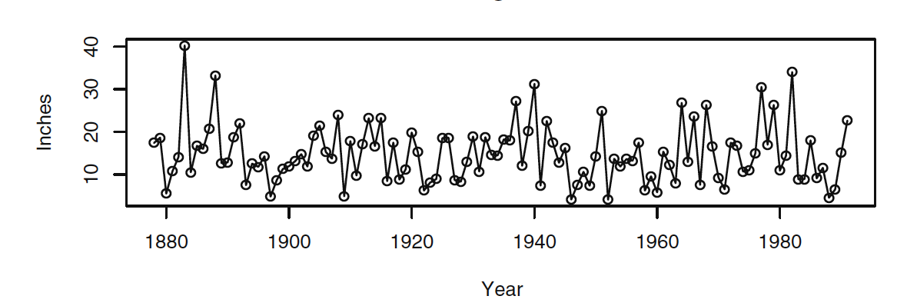
What is time series
Observations collected sequentially over time
Purpose:
Understand stochastic process leading to an observed series
Predict future values
Feature:
Observations are usually not independent
Example: Time Series Plot of Los Angeles Annual Rainfall
Need models that incorporate dependence!!

Slide 3
Modeling process
Model specification (or identification)
Time plot of the series
Explorative analysis
Principle of parsimony: smallest number of parameters
Model fitting
Find the best possible estimates of those unknown parameters
Consider least squares, maximum likelihood estimate, etc
Model diagnostics
Asses the quality of the specified model
Then either use the model to forecast future values, or return to model specification

Slide 4



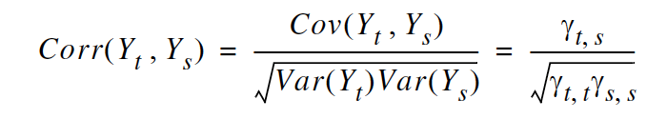
Important concepts
Stochastic process
The sequence of random variables {Yt : t = 0, ± 1, ± 2, ± 3,… }
Stationarity
Trends, seasonality
Mean function
Autocovariance function
Autocorrelation function
compute the correlation between the pairs k units apart in time
where

Slide 5


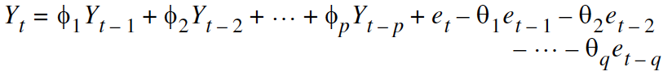
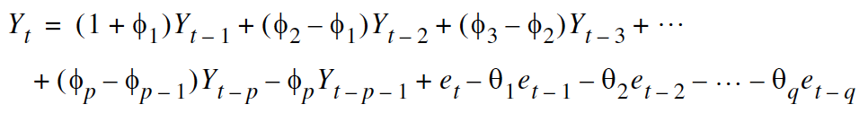
Parametric time series models
Autoregressive process: AR(p)
Regression on themselves
Moving average of order q: MA(q)
finite number of the ψ -weights are nonzero
Autoregressive moving average models (or Box-Jenkins models): ARMA(p,q)
Integrated autoregressive moving average model: ARIMA (p,d,q)
Nonstationary

Slide 6
Example
Data Description
The dataset records a time series: 668 observations ranging from January 1st 2015 to November 6th 2016.
Methodology
Exploratory data analysis
Data transformation
Define best ARIMA models using AIC
Seasonal effects: time-wise analysis
Periodic trends: spectral analysis
Make prediction
Data fitting

Slide 7
Q & A

